Slide 1


Detection of precancerous tissue in histological images of the intestine
Camilla Iorio 1852512

Slide 2
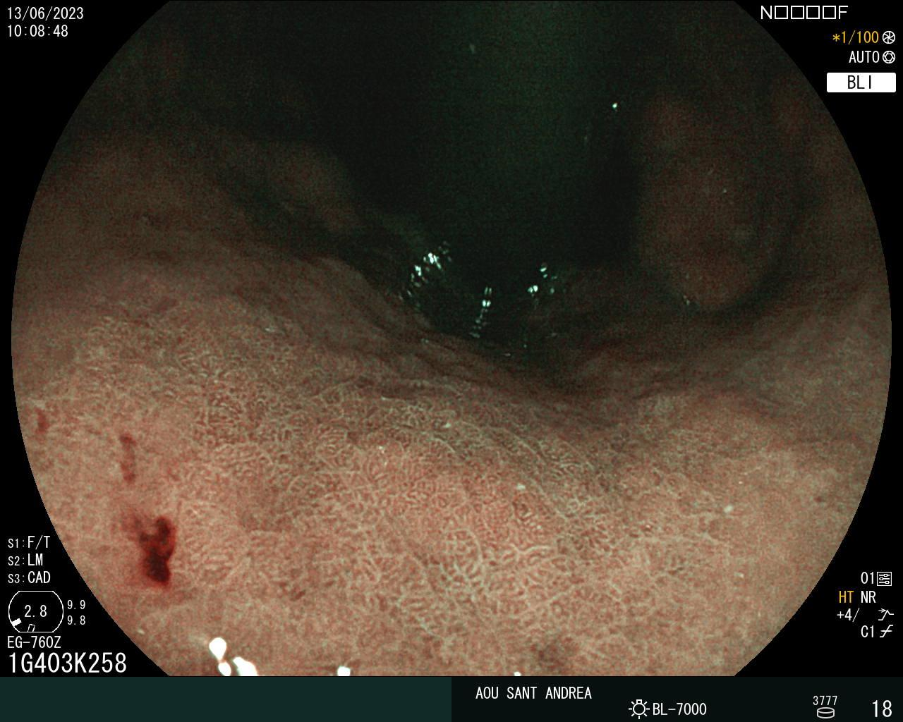
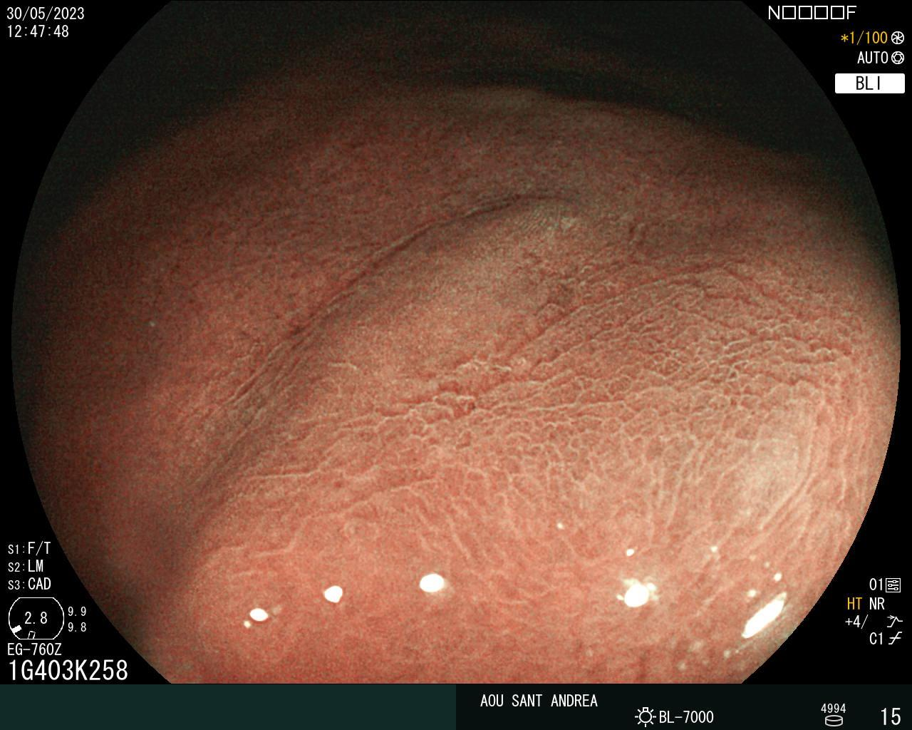
The setting:
Positive
Negative

Slide 3
The idea
The Goal is to preprocess data and classify histological images.
1. Patching extraction
2. Do classification task (H-Net)
Output: images classified

Slide 4
Dataset Overview
The dataset consists of histological images of intestinal tissue.
Two categories:
positive (containing precancerous tissue).
negative (without precancerous tissue).
Total images in dataset: 969
Proportions between classes: 2/3 negative and 1/3 positive.
Segmentation provided by the dataset.

Slide 5
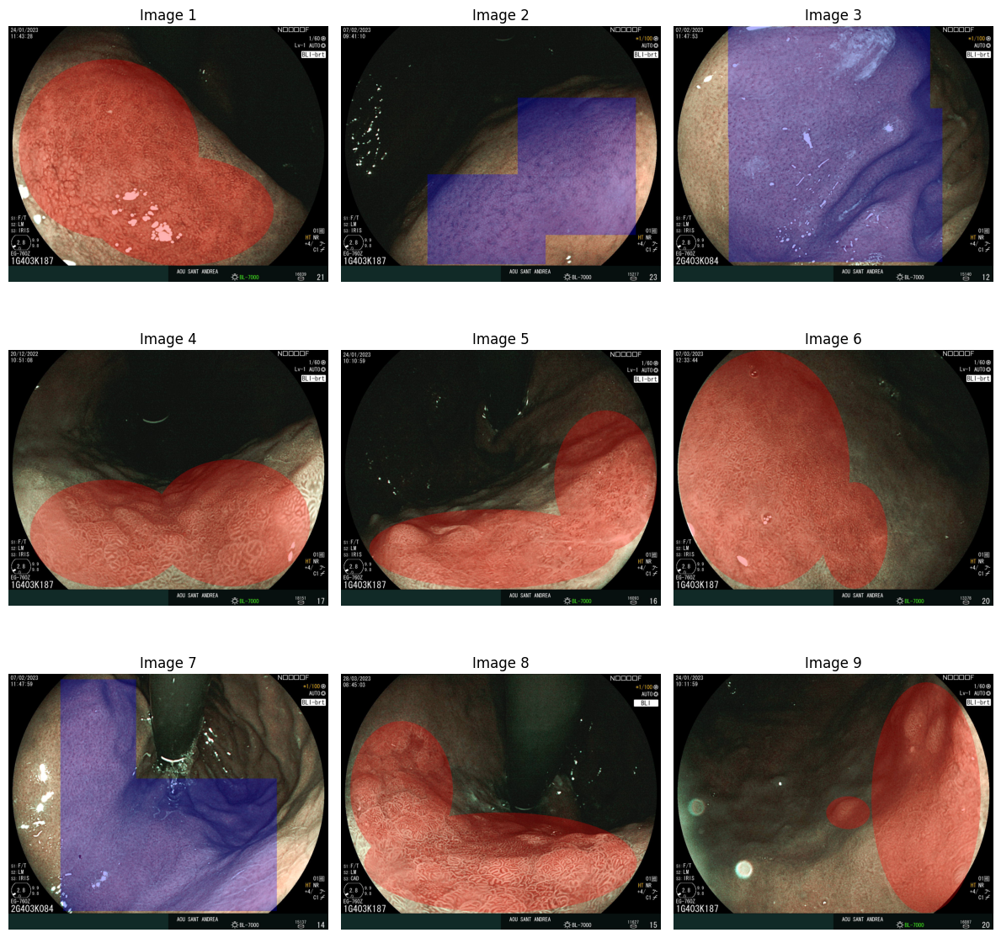
Dataset Overview
The segmentation mask
It visually highlights the unclear segmentation.
The segmentation mask uses the following values:
1: Negative region (not affected by metaplasia).
2: Positive region (influenced by metaplasia).
0: Region of no interest.

Slide 6
Challenge to face:
Approximated segmentation challenge
Small Dataset Challenge

Slide 7
Challenge to face:
Approximated segmentation challenge
Extraction of patches from segmented images with assignment of class labels.
Small Dataset Challenge

Slide 8
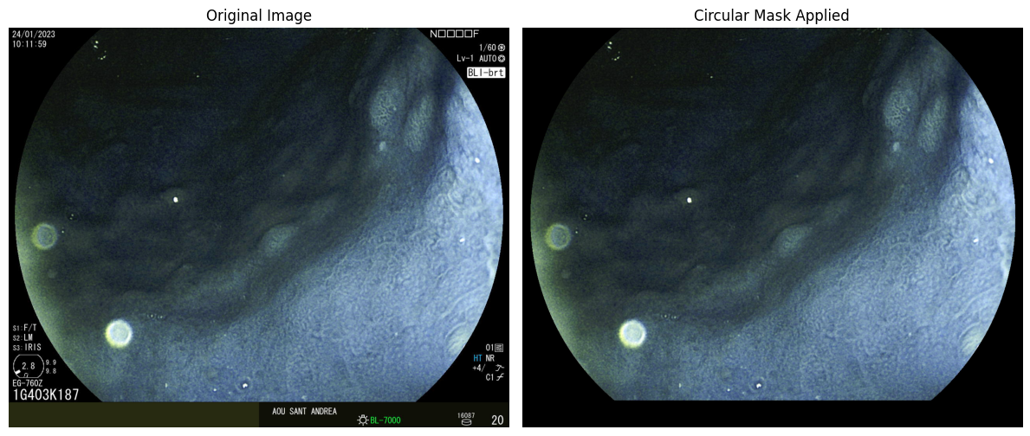
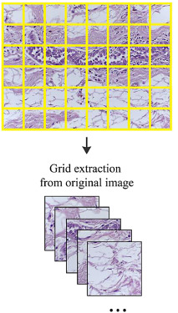
1. Approximated segmentation challenge
Three phases:
1. Preprocessing
Removing texts in the image
Patches extraction
Patches labeling
Create a batch of patches
2. Training of classification model
3. Voting scheme

Slide 9
Challenge to face:
Approximated segmentation challenge
Small Dataset Challenge
Harmonic networks have been proposed as an advanced solution for classification on small datasets.

Slide 10
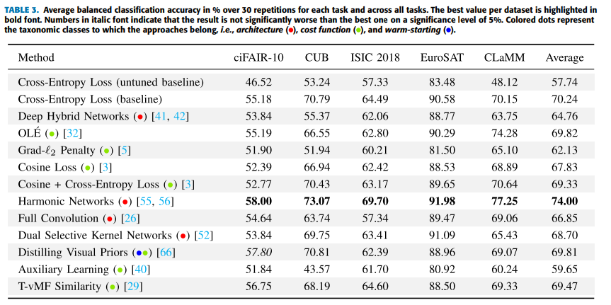
2. Small Dataset Challenge
Image Classification With Small Datasets: Overview and Benchmark

Slide 11
2. Small Dataset Challenge: The Harmonic networks
CNN
H-Net
Translation equivariance but no rotation equivariance
Translation equivariance and 360°rotation equivariance
Needs data augmentation to embed rotational equivariance
Hard-baking rotational equivariance
Use of convolutional filters.
Use of circular harmonics
Can’t handle small datasets
Can handle small datasets
Less computational cost
Higher computational costs

Slide 12
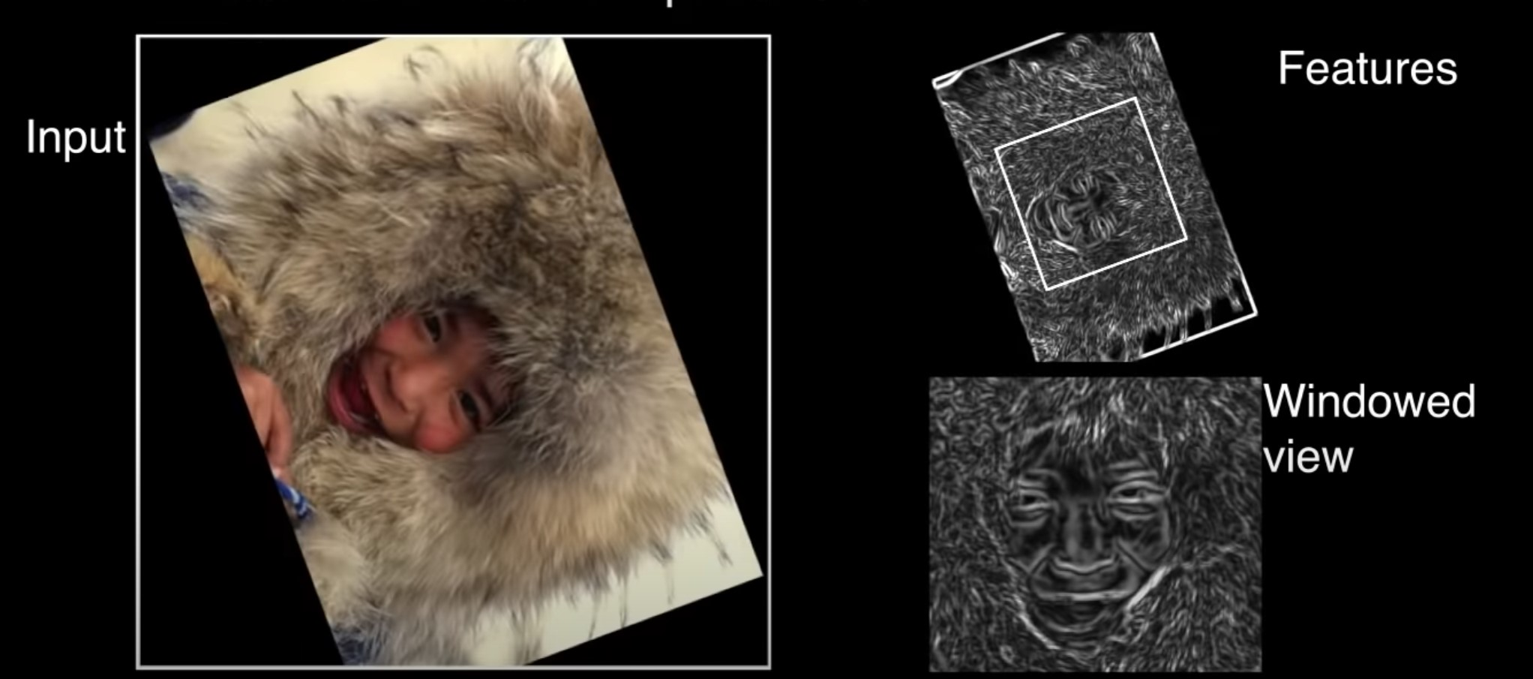
360°rotational equivariance
Rotational equivariance is allowed by circular harmonics.
This property is also important for histopatological images.

Slide 13
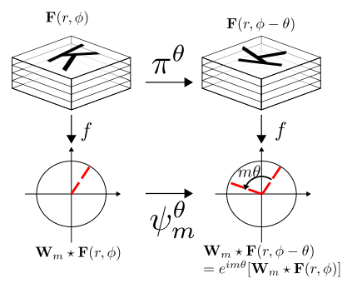
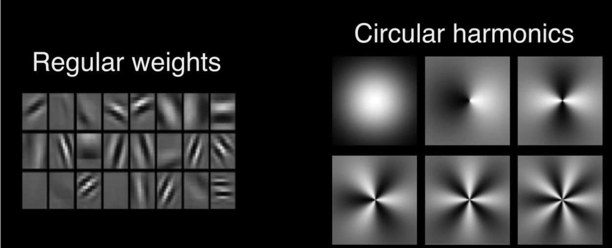
Circular harmonics
Allow rotational equivariance.
For CNN: using many filters in several discrete directions.
With H-Nets: using a single filter sensitive to rotation.

Slide 14
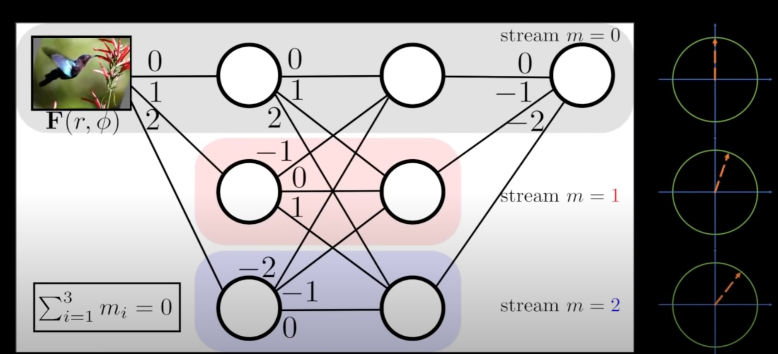
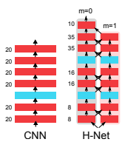
Structure of the network
Equivariance rotation for each layer
Multiple channels to avoid entanglement
Each stream represents a series of feature maps of constant rotation order
Connected together with cross-correlation of rotation order equal to the difference between those two streams.

Slide 15
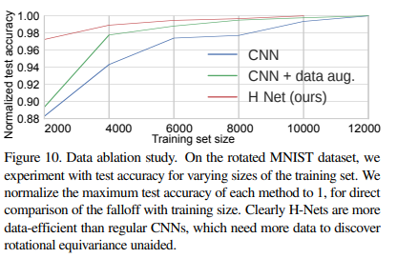
Performance results
Pro:
Better on small datasets
Cons:
Higher computational cost

Slide 16
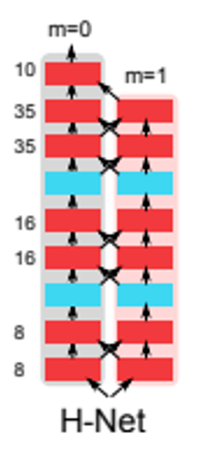
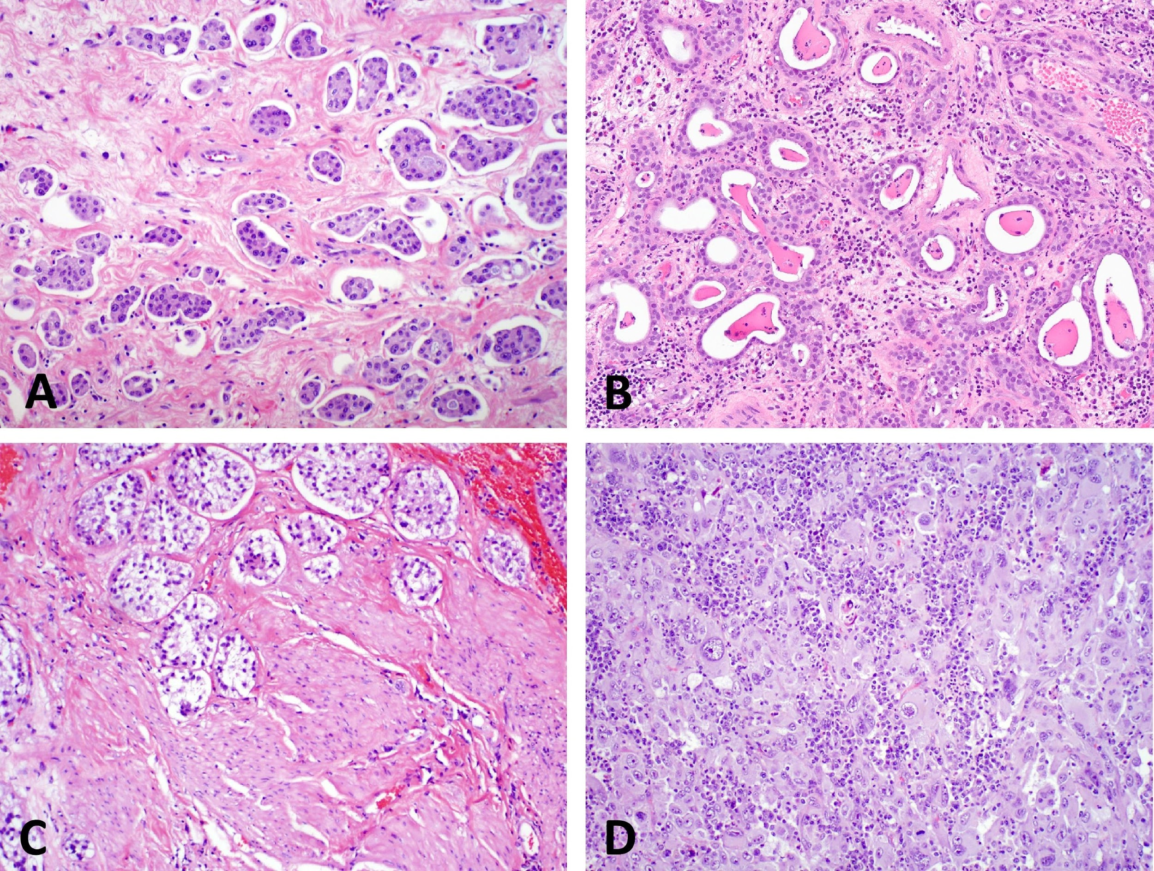
Approach scheme
Positive
Positive
Positive
Positive
Negative
Patch extraction
Classification task
Voting scheme
Classification

Slide 17
THANK YOU FOR YOUR ATTENTION

